Slide 1




NEXT GEN EMPLOYABILITY PROGRAM
Creating a future-ready workforce
Team Members
College Name
Student Name : Jones Winslet
Student ID :311121205031
LICET

Slide 2

CAPSTONE PROJECT SHOWCASE
Project Title
Building Bus Reservation using Django Framework
Abstract | Problem Statement | Project Overview | Proposed Solution | Technology Used | Modelling & Results | Conclusion

Slide 3
Abstract
This project aims to develop a Bus Reservation System using Python and the Django web framework, catering to the growing demand for efficient transportation management solutions.
By leveraging Django's robust features such as ORM for database management and built-in authentication, the system will offer user-friendly functionalities including user registration, bus route management, seat availability tracking, booking management, payment integration, and administrative controls.
Through adherence to best practices in software development, the system aims to provide a seamless and intuitive platform for passengers to book tickets and for bus operators to manage their services effectively, ultimately enhancing the overall experience of bus travel.
Source :

Slide 4
Problem Statement
The problem statement for this project is the need for a comprehensive and user-friendly Bus Reservation System to streamline the process of booking bus tickets and managing bus services efficiently.
The current lack of an integrated solution leads to inconveniences for passengers and operational challenges for bus operators.
Therefore, the project aims to develop a system using Python and Django that addresses these issues by providing features such as user registration, route management, seat availability tracking, booking management, payment integration, and administrative controls, ultimately enhancing the overall experience of bus travel for both passengers and operators.
Source :

Slide 5
Project Overview
The project entails the development of a Bus Reservation System using Python and Django, aimed at addressing the inefficiencies in the current bus ticket booking and management processes.
It will offer a user-friendly platform for passengers to book tickets seamlessly and enable bus operators to efficiently manage their services.
Key features include user registration, route management, seat availability tracking, booking management, payment integration, and administrative controls, with the goal of enhancing the overall experience of bus travel for all stakeholders.
Source :

Slide 6
Proposed Solution
.
The proposed solution is a Bus Reservation System developed using Python and Django, offering a comprehensive platform for users to effortlessly book bus tickets and for operators to efficiently manage their services.
Through features such as real-time tracking, dynamic pricing, multi-language support, loyalty programs, mobile applications, and integration with third-party services, the system aims to revolutionize the bus travel experience by enhancing convenience, efficiency, and overall customer satisfaction.
Source :

Slide 7

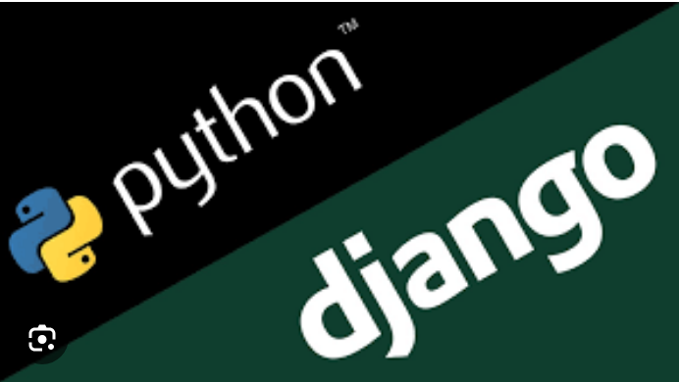
Technology Used
Front-end
Back-end
Source :

Slide 8
Modelling & Results
The project involves modeling the Bus Reservation System using Django's ORM for database management, implementing features such as user authentication, bus route management, seat availability tracking, booking management, payment processing integration, and administrative functionalities.
Results include a fully functional system that provides a seamless and intuitive platform for passengers to book tickets and for bus operators to manage their services efficiently, thereby enhancing the overall experience of bus travel for all users.
Through meticulous modeling and implementation using Python and Django, the Bus Reservation System encompasses a robust architecture that ensures scalability, security, and ease of maintenance.
By adhering to best practices in software development, including thorough testing and documentation, the system delivers reliable results.
Users experience a streamlined booking process, while operators benefit from simplified service management.
Overall, the project yields a sophisticated solution poised to optimize bus travel operations and enhance user satisfaction.
Source :

Slide 9
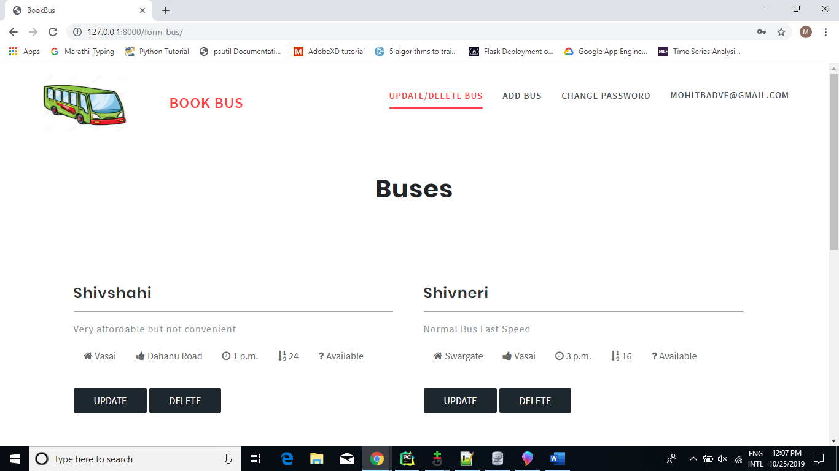
Home page

Slide 10
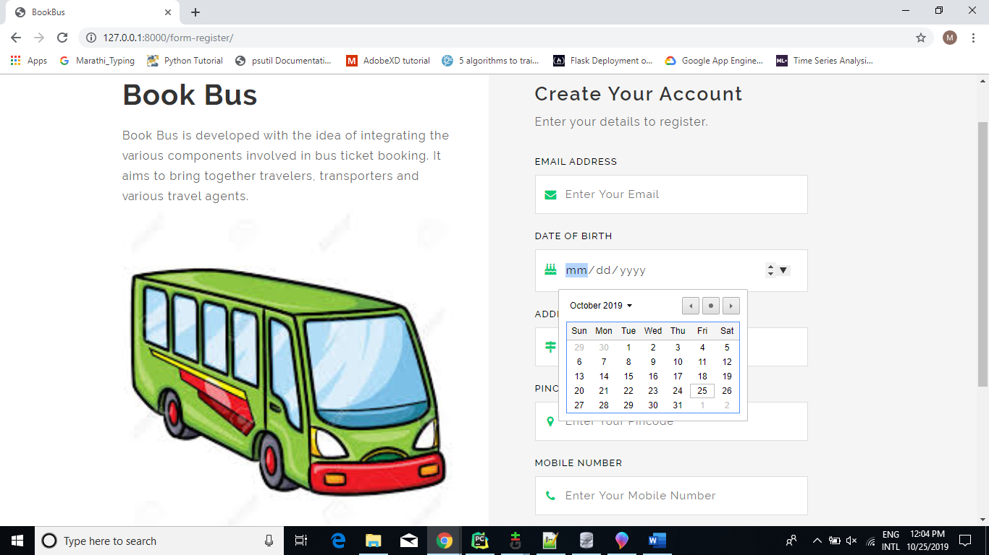
Register Page

Slide 11
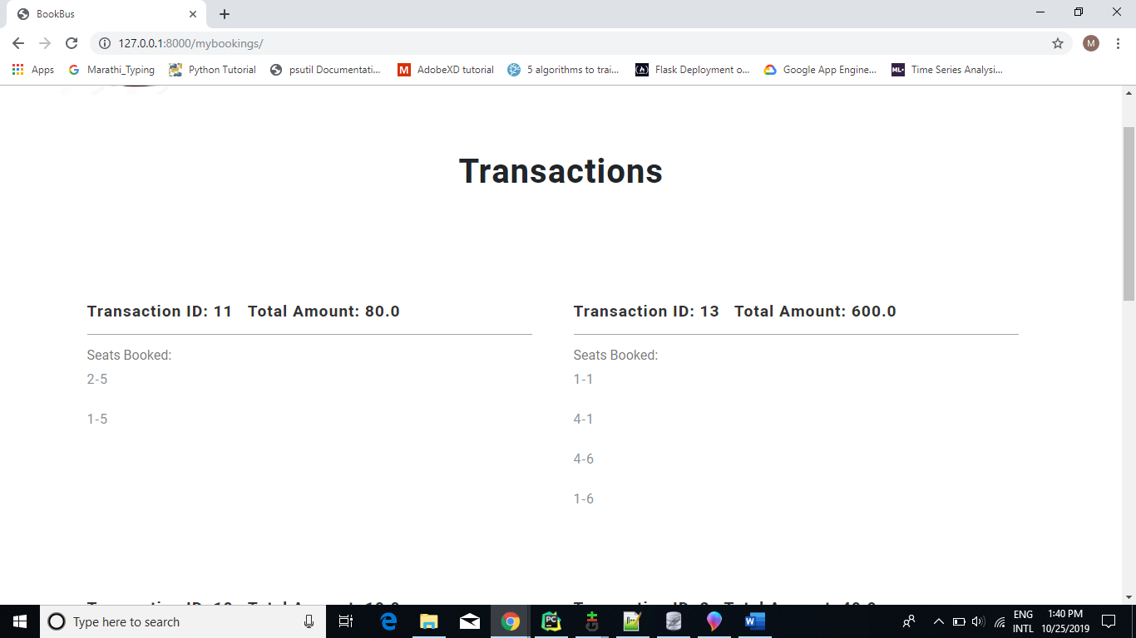
Bookings Page

Slide 12
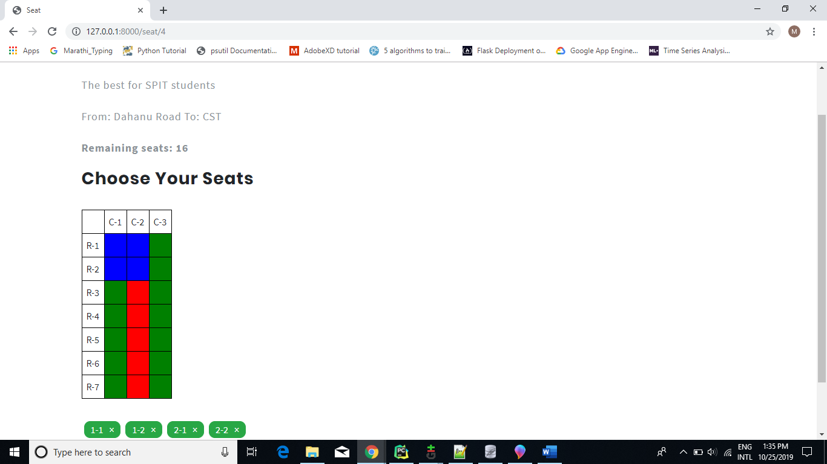
Seats page

Slide 13
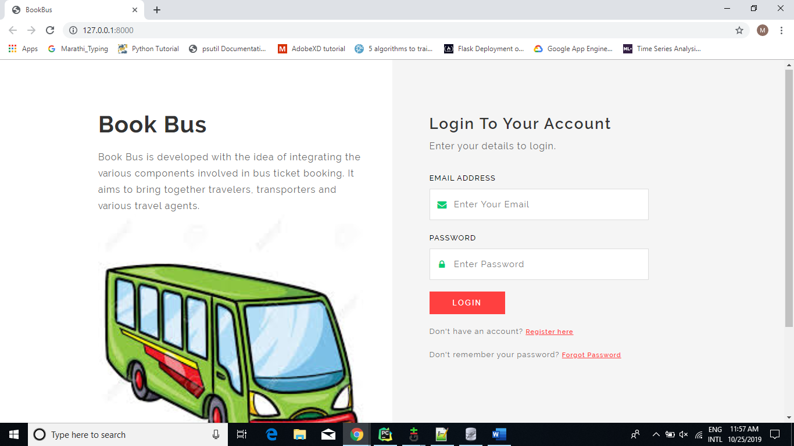
Login page

Slide 14
Future Enhancements:
Future enhancements for the Bus Reservation System could involve the integration of real-time bus tracking for passengers' convenience, dynamic pricing algorithms to optimize revenue, multi-language support for broader accessibility, loyalty programs to incentivize frequent travelers, development of dedicated mobile applications for on-the-go booking, and integration with third-party services such as hotel reservations or travel insurance providers.
These additions aim to improve user experience, increase revenue opportunities, and keep the system competitive in the evolving landscape of transportation services.
Potential future enhancements for the Bus Reservation System include the implementation of advanced analytics capabilities to gather insights from booking data, allowing operators to optimize routes, schedules, and fleet management.
Additionally, integration with IoT (Internet of Things) devices could enable proactive maintenance of buses, reducing downtime and improving reliability.
Furthermore, the system could incorporate AI-driven chatbots to provide instant customer support and personalized recommendations, enhancing user satisfaction.
Embracing emerging technologies and data-driven approaches will empower the system to continuously evolve, meeting the changing needs of passengers and operators in the dynamic transportation industry.

Slide 15
Conclusion
In conclusion, the development of the Bus Reservation System using Python and Django presents a robust solution to streamline bus ticket booking and management processes.
With its user-friendly interface, comprehensive features, and potential for future enhancements, the system aims to enhance the overall experience of bus travel for passengers and operators alike.
By leveraging advanced technologies and data-driven approaches, the system is poised to adapt to evolving industry trends and meet the dynamic needs of the transportation sector, ultimately contributing to improved efficiency and customer satisfaction in bus services.
In summary, the Bus Reservation System developed with Python and Django offers a scalable, secure, and intuitive platform for users to seamlessly book bus tickets and for operators to efficiently manage their services.
By incorporating features such as real-time tracking, dynamic pricing, multi-language support, loyalty programs, mobile applications, and integration with third-party services, the system demonstrates its potential for continual growth and adaptation to meet evolving industry demands.
With a focus on enhancing user experience and leveraging emerging technologies, the Bus Reservation System stands as a valuable asset in revolutionizing the bus travel landscape, driving towards greater convenience, efficiency, and customer satisfaction.
Source :

Slide 16
Thank You!
Notes:
Thank You !!

